Slide 1
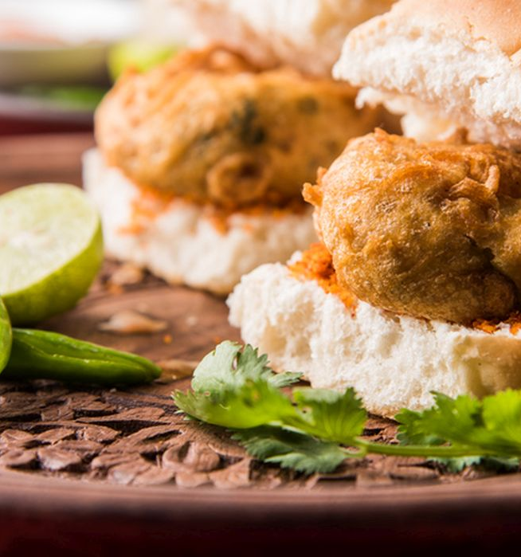
Case Study-New vada Pav shop(SID Vada WALA)
A Study for new Vada Pav shop near Location-Shivaji Nagar, Pune.
Notes:
Links:
https://www.pexels.com/photo/two-imac-s-with-keyboard-and-phones-on-desk-326503/

Slide 2
Introduction
Problem Statement : A man wants to open a Wada Pav Shop near Shivaji Nagar in Pune. He has got a location where there are other 4 more Wada pav shops. He is not able to understand what will be the strategy to take over his clients.
Starting a Vada pav outlet does not involve much investment.
The government licensing fee is also very nominal.
The raw materials are easily available.
The switching cost, in case the business does not work well, is also very small.
Vada pav has been born from Mumbai and tourists want to taste of Mumbai Vada pav.
Outlets have been opened at places that are usually mopped by locals and tourists.
Notes:
Links:
https://www.pexels.com/photo/group-of-people-using-laptops-1560932/

Slide 3


Using Penetration method to Price comparison :-
Notes:
Links:
https://pixabay.com/vectors/business-meeting-company-team-5840870/

Slide 4
Positioning of Food products:
A good quality product with different verity.
Standard row material and fresh food for customers.
Middle and low income group people.
Mainly Student, couples, employees.
Clean and hygienic branded Vada pav.
Low price with best quality compare to others.
Best Services & Amenities compare to others.
Notes:
Links:
https://pixabay.com/vectors/business-meeting-company-team-5840870/

Slide 5
Facilities and Differentiations:-
Amenities
Outdoor Seating
Family Seating
Serves
Non Veg
Parking
Available
e-Wallets
Accented
Social media platform
Instagram
Facebook
What's app
Just dial
Food blogs WordPress
Payment mode
Cash BHIM
UPI
G-PAY
Phone Pay
Delivery
Online delivery +Quick service quality
Zomato
Swingy
Food panda
Notes:
Links:
https://pixabay.com/vectors/business-meeting-company-team-5840870/

Slide 6
SWOT ANALYSIS
Strengths:-
The idea behind “SID VADA WALA” there was to make an earthy Indian street food into a saleable fast food.
Affordable, clean, ethnic fast food.
Easily accessible and saves time.
Targets low income customers.
Though the quality approach is global, the local flavors is intact.
Weaknesses/ Problems:-
Conventional Model of hiring a cook & staff.
The handmade patties varied in quality & had a short shelf life & were even pilfered.
Step rises in raw materials costs puts margins under pressure.
Risk of shutting down incase the cook moves out.
Fund Raising & Real Estate (in Pune)
No investors were ready to put their money.
Notes:
Links:
https://www.pexels.com/photo/photo-of-people-doing-handshakes-3183197/
https://www.pexels.com/photo/photo-of-person-using-laptop-3183145/

Slide 7
Opportunities/Solution
Varied Marketing Techniques -USP
Promotional Techniques- Word of Mouth
A Strategy to have locations in high streets & main market places Brand expansion.
Variety of flavor's and Recommended products.
Threats
Competition from foreign brands like McDonalds, Burger King.
Lack of innovative products.
Struggle to establish the brand name and to be popular globally.
Withstanding market expectations.
Notes:
Links:
https://pixabay.com/vectors/business-meeting-company-team-5840870/

Slide 8
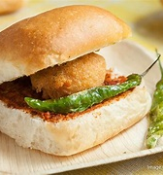
THANK YOU!
Notes:
Links:
https://www.pexels.com/photo/two-imac-s-with-keyboard-and-phones-on-desk-326503/

